Slide 1
Big Data Analysis of Healthcare Data
BY
Lakshmi Sireesha Pavalla S543026
Anudeep Somarouthu S545543
Niharika Sanamsetty S545249
Swapna Dasari S544719
Rajashekhar Kota S545008

Slide 2
Contents
Introduction Of Project
Explanation Healthcare data set in terms of Big Data
Goals Of The Project
Tools and Technologies used in the project
Block Diagram
Discussion of results of each goal
Conclusion

Slide 3
Introduction Of Project
Here we would like to analyze the data of hospitals located in California in USA in various aspects. In the first place we would like to clean the data and also format the unstructured data to a structured data. Using the tools and technologies like databricks, PySpark, SQL, Hadoop MapReduce would like to analyse the goals.

Slide 4
Explanation Healthcare data set in terms of Big Data
Volume: By Using big data analytics we are processing California state hospital quarterly financial and utilization data files, data contains following records, quarterly data file labels quarters ended 2015 and after, it has records quarterly report information, general hospital information, utilization data, hospital discharges, patient days, outpatient visits, gross impatient revenue, gross outpatient revenue, deductions from revenue, capitation premium revenue, net patient revenue, other revenue and expense data, purchased inpatient services, purchased outpatient services, other financial data items, covered California, quality assurance fee program, we process the data with all these records.
Velocity: we are expecting the data can be processed, stored and analyzed by relational database by increasing speed, we are going to observe the speed at which new data is generated and the speed at which data moves around.
Variety: The variety of structured and unstructured data increases the complexity of storing and analyzing data. we are generating data that is in unstructured form.
Veracity: The accuracy of data analysis depends on the veracity of the data, we make sure the data doesn’t contain any duplicate data, we also make sure the data going to be accurate by removing unwanted data.
Value: It is one of the important aspects in bigdata, with this California state hospital data, one can easily access information about hospitals which is useful for both the faculty and patients

Slide 5
Goals Of The Project
1.In which locality highest no of health care units are observed?
2.In which locality lowest no of health care units are observed?
3.Display the number of healthcare centers in every City?
4.Segregate the count of hospital list depending upon the central type of each state
How many are Non-profit Corp?
How many are church?
5.For Which For which hospital highest no of available beds are recorded?
6.For which hospital least no of available beds are recorded?
7.Find the count of distinct HSA (Health Savings Account) on overall health care data
8.Categorize the hospital based on its type
How many are Psychiatric Health Facilities?
How many are Comparable?
9.Highest capacity of licensed beds for hospitals
10.Lowest capacity of licensed beds for hospitals
Based on this data we will a have a clear picture of how strong or weak
California region exists in healthcare.

Slide 6

Tools and Technologies used in the project
Databricks
PySpark
SQL
Hadoop MapReduce

Slide 7
Data bricks: Data bricks is used to process, store, clean, share, analyze, model data sets, by using data bricks we have extracted following results from our data set which are highest and lowest capacity of beds, highest and lowest count of beds, highest no of health care units.
PySpark: PySpark is an open source, distributed computing platform and collection of tools for real-time, massive data processing with Pyspark we have shown some visualizations with our data.
SQL: By Using SQL statements we have obtain results from our dataset
Hadoop MapReduce: A software framework named Hadoop MapReduce makes it simple to create applications that efficiently handle huge amounts of data in parallel on large clusters of affordable hardware. By Using this we have extracted count of non-profit corporation and psychiatric health facilities and how many are comparable.

Slide 8
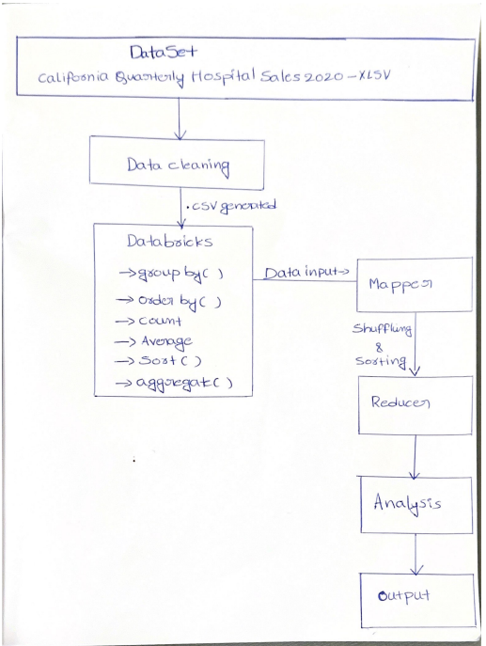
Block Diagram

Slide 9
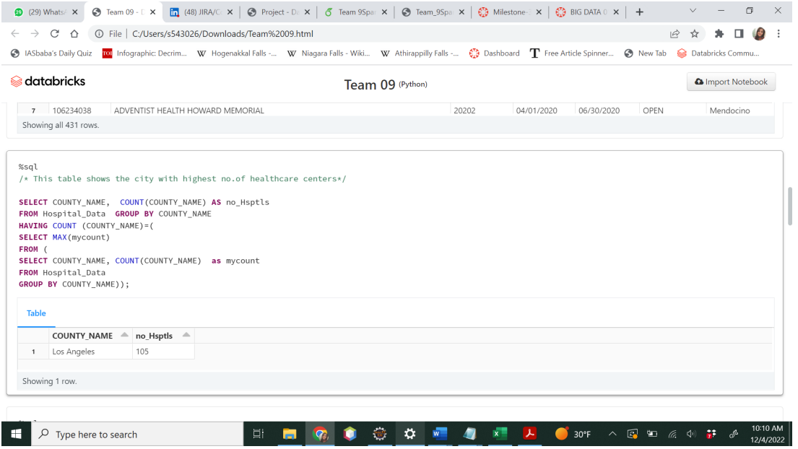
Discussion of results of each goal
In which locality highest no of health care units are observed?
The figure shows results for In which locality highest no of health care centers are observed? According to the results Los angels topped the highest health care centers with 105 health care units in it.

Slide 10
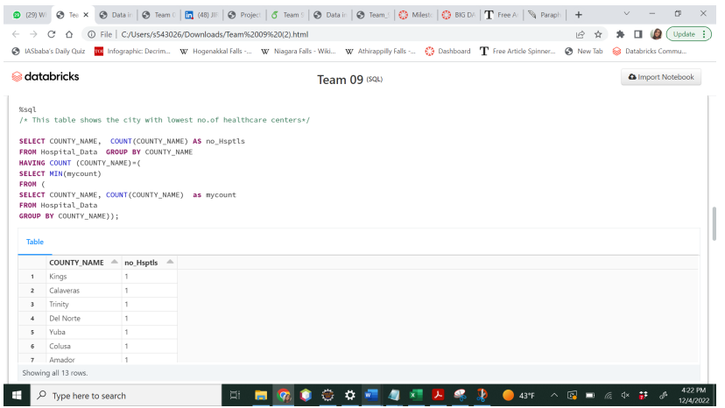
In which locality lowest no of health care units are observed?
The figure shows results for In which locality Lowest no of health care centers are observed? According to the results there are multiple cities with Lowest health care centers

Slide 11
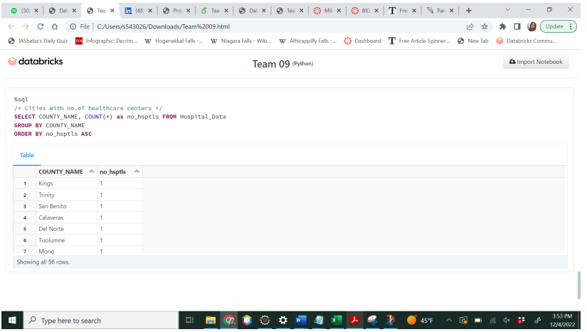
Display the number of healthcare centers in every City?
The figure shows results of number of healthcare centers in cities According to the results, we can clearly see the cities and number of healthcare centers.

Slide 12
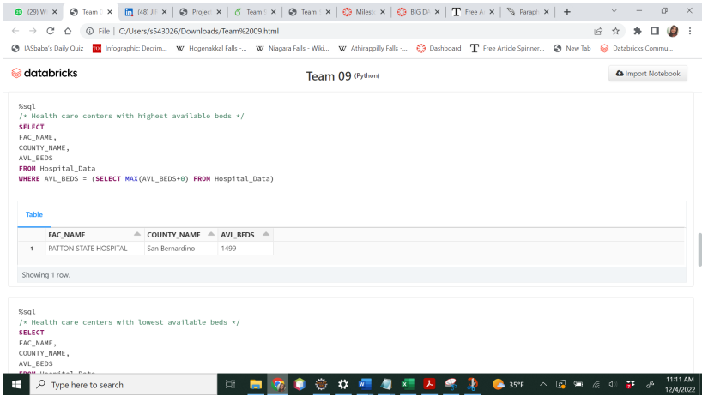
For Which For which hospital highest no of available beds are recorded?
The figure shows results For which hospital highest no of available beds are recorded According to the results PATTON STATE HOSPITAL recorded top with 1499 available beds and it is located in San Bernardino, to get these results i have used SQL commands by using data bricks.

Slide 13
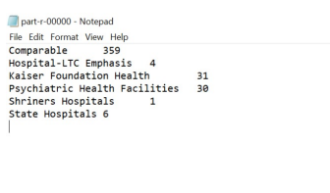
Categorize the hospital based on its type
The above output shows the Count of each individual type of Hospital. From the Output we can see highest number of Comparable Hospital and Lowest number of shiners Hospital

Slide 14
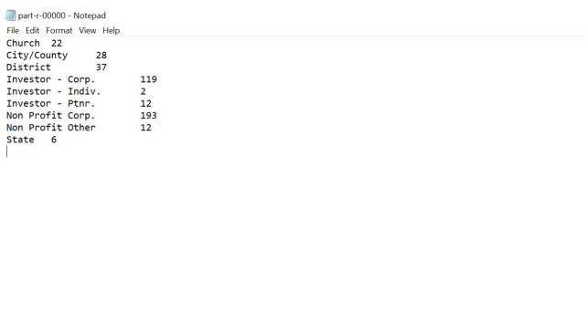
Segregate the count of hospital list depending upon the central type of each state
The above output shows the Count of each individual type of Central. From the Output we can see highest number of Non-Profit Corp. and Lowest number of Investor- Individual.

Slide 15
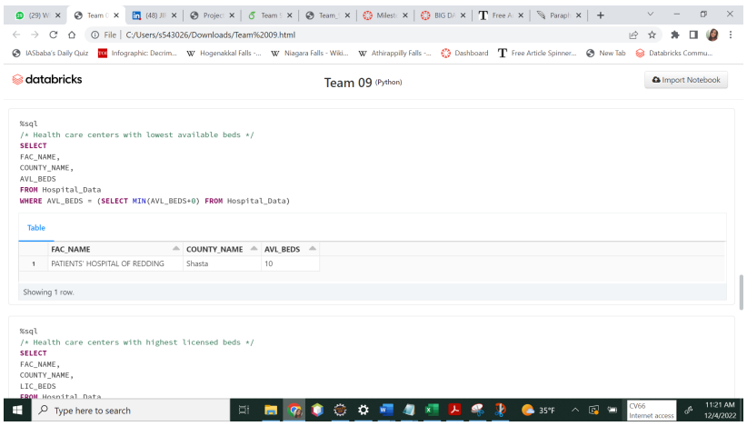
For which hospital least no of available beds are recorded?
The figure shows results For which hospital lowest no of available beds are recorded According to the results PATIENTS’ HOSPITAL OF REDDING recorded lowest available beds with 10 beds and it is located in Shasta, to get these results i have used SQL commands by using data bricks

Slide 16
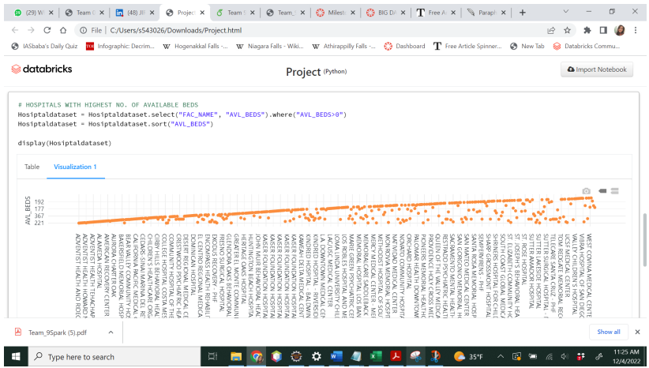
For Which For which hospital highest and Lowest no of available beds are recorded?
The figure shows results For which hospital highest and lowest no of available beds are recorded According to the results PATTON STATE HOSPITAL, PATIENTS’ and HOSPITAL OF REDDING recorded highest and lowest available beds with 1499 and 10 beds and located in San Bernardino and Shasta, to get these results i have used pyspark commands by using data bricks

Slide 17
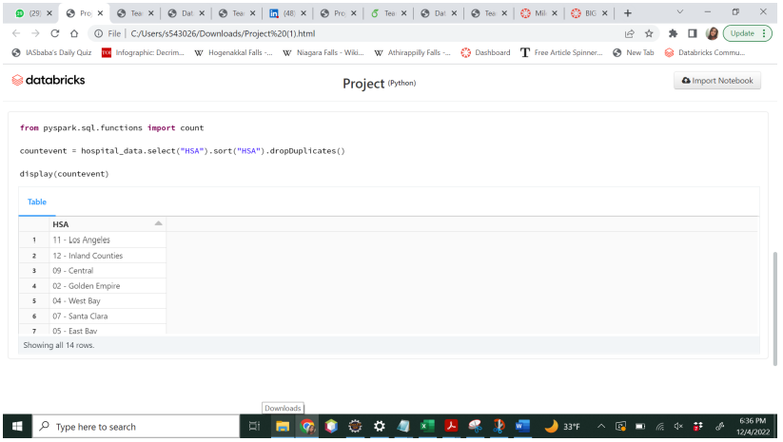
Find the count of distinct HSA (Health Savings Account) on overall health care data
The Output displayed to find the count of hospitals in a locality who has HSA(Health Savings Account) Output Displayed for the below Goal: The above figure shows results of Health Service Area (HSA) of hospitals According to the results over all there are 14 different HSA and are present among 431 hospitals and in those 14 there are repeated several times i.e The hospitals have same HSA to get these output using a pyspark command dropDuplicates which filter and display the exact number of HSA

Slide 18
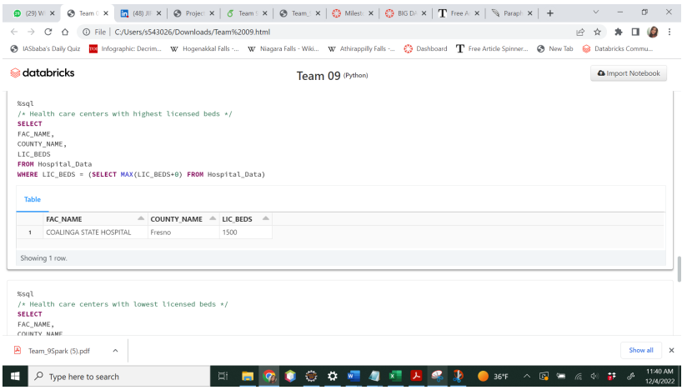
Highest capacity of licensed beds for hospitals
The above figure shows results Highest capacity of licensed beds for hospitals According to the results COALINGA STATE HOSPITAL recorded highest licensed beds located in Fresno with 1500 beds, to get these results i have used SQL commands by using data bricks

Slide 19
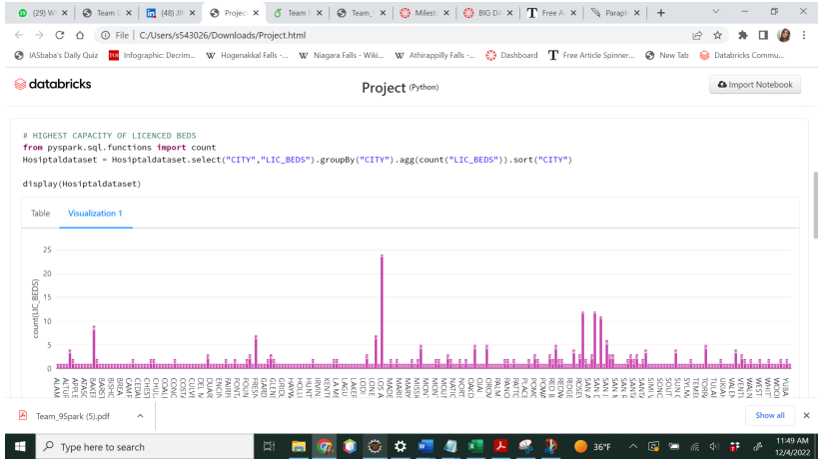
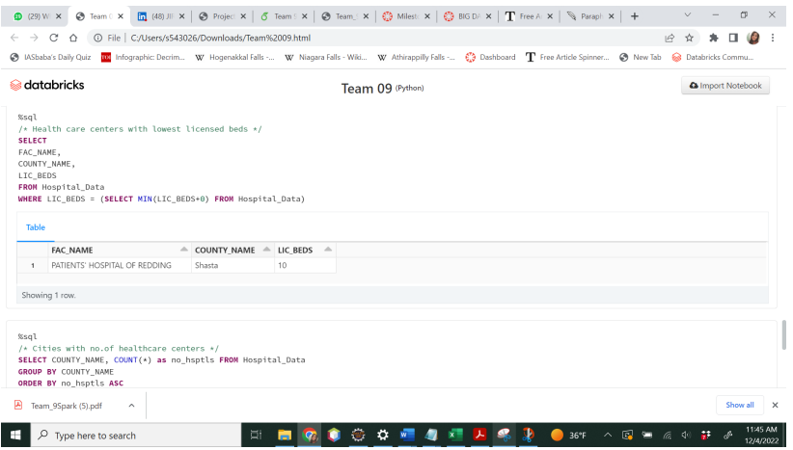
Lowest capacity of licensed beds for hospitals
According to the results, COALINGA STATE HOSPITAL,PATIENTS’ HOSPITAL OF REDDINGL recorded lowest licensed beds located in Fresnoand Shasta with 1500 and 10 beds, to get these results i have used Pyspark commands by using data bricks.
.The above figure shows results Lowest capacity of licensed beds for hospitals According to the results PATIENTS’ HOSPITAL OF REDDINGL recorded lowest licensed beds located in Shasta with 10 beds, to get these results i have used SQL commands by using data bricks.

Slide 20
CONCLUSION
We successfully accomplished our objectives with the help of Hadoop, MapReduce, DataBricks, SQL, and PySpark. The primary goal of analysis is to provide useful information for those who are looking for healthcare information
From the above results we can conclude that highest number of healthcare centers are in Los angels and lowest number of number of health care centers are observed in multiple cities from this we can say that more health care centers need to be built in that respective areas.
Based on the type of central there are highest number of hospitals are categorized as non-profit corporations, and lowest number of hospitals are categorized as investor individual.
Patton state hospital recorded highest available bed in san barnardino, from this we can conclude people near by in this locality can prefer this hospital who are looking for available beds.
Patients hospital of Redding recorded lowest available beds located in shata

Slide 21


